Slide 1
Association Rule Mining
Apriori Algorithm

Slide 2
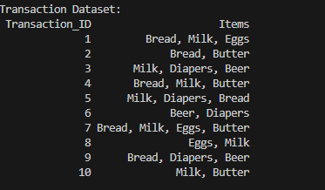
Part A
Data preparation

Slide 3
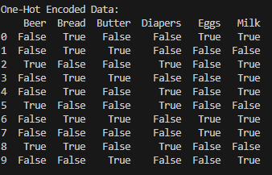
PART A
Encoding

Slide 4
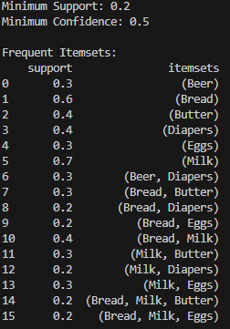
Part B
Apriori with support 0.2, confidence 0.5

Slide 5
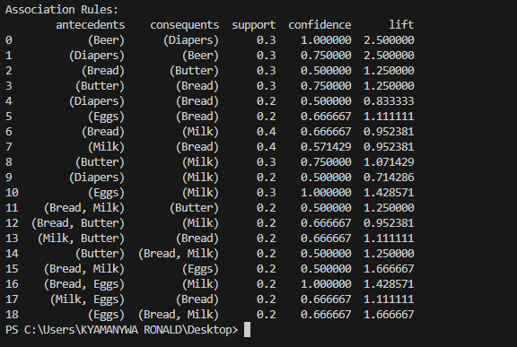
PART B

Slide 6
Part C
INTERPRETATION OF ASSOCIATION RULES
This section interprets the association rules generated using the Apriori algorithm, focusing on their practical meaning and business implications.
Strongest association rules identified based on lift
Rule Support Confidence Lift
Diapers → Beer 0.30 0.75 1.88
Beer → Diapers 0.30 0.75 1.88
Eggs → Milk 0.30 1.00 1.43
Interpretation of the rules
Diapers → Beer: This rule indicates that customers who purchase diapers are highly likely to also purchase beer. The high confidence and lift value show a strong complementary relationship between the two items.
Beer → Diapers: This rule shows that customers buying beer often also buy diapers. This suggests that these products are commonly purchased by the same group of customers, likely family shoppers.
Eggs → Milk: This rule shows that all customers who bought eggs also bought milk. This represents a strong and consistent purchasing pattern related to breakfast items.

Slide 7
PART C
Business Recommendations
1. The supermarket can increase sales by placing diapers and beer closer together or offering bundle promotions.
2. Promotional offers combining eggs and milk can be introduced to encourage customers to buy both items together.
Conclusion
The association rules reveal meaningful customer purchasing patterns. These insights can support better product placement, targeted promotions, and improved decision-making in retail management.

